Slide 1
Early China:
The Qin and Han Dynasties
221 BCE-220 CE

Slide 2
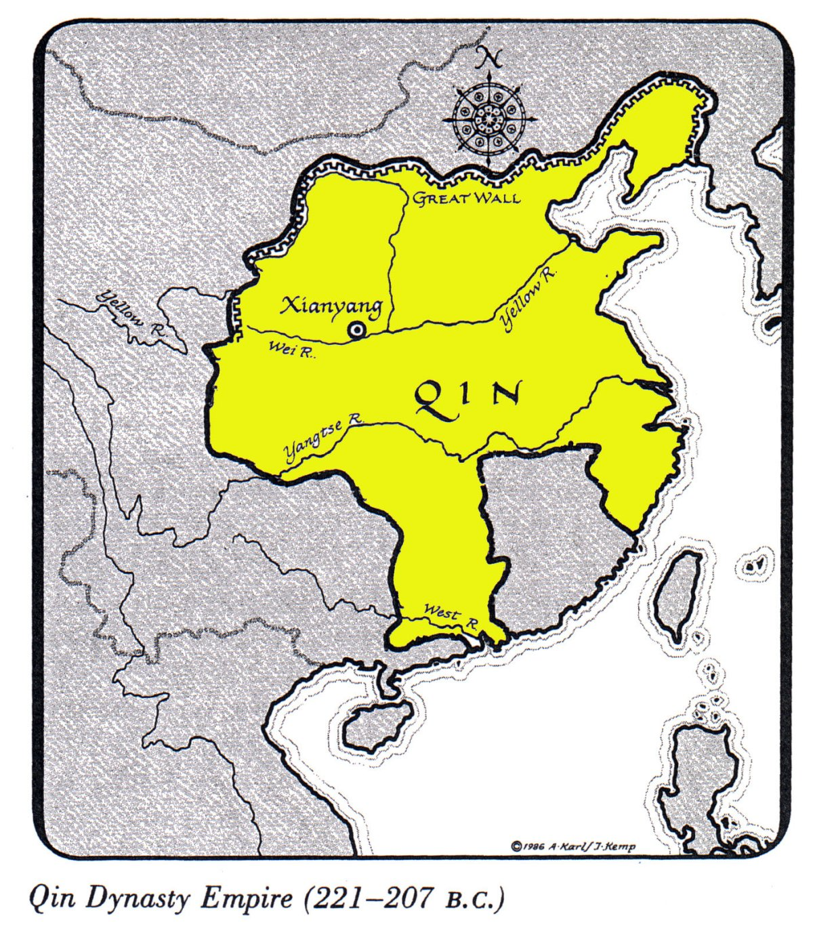
The Extent of the Qin (221 BCE-207 BCE)

Slide 3


China under the Qin Dynasty
Shi Huangdi establishes an autocracy, a government with unlimited power—moves nobles to the capital…why?
  Legalist policies
Built highways, set standards for law, currency, and weights, builds canals, expands trade, UNIFIED CHINA
Notes:
He can better keep an eye on nobles to keep them from amassing power and influence

Slide 4
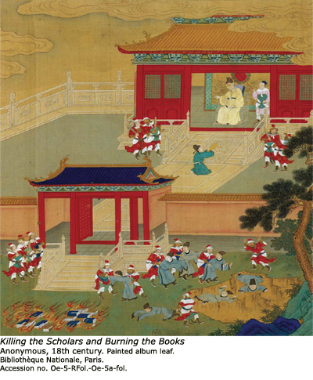
“Strengthening the trunk, killing the branches.”
Jailed, tortured and killed all critics
He burned all books of Confucian thinkers or any critics of Legalism.
Buried Confucian scholars alive

Slide 5
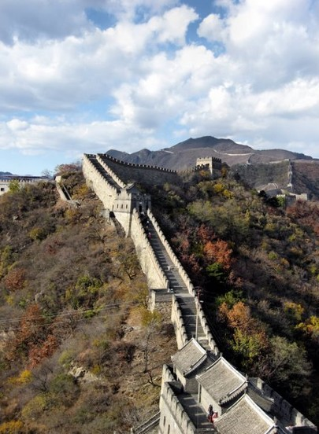
The Great Wall
  Designed to keep out northern invaders, symbol of the strength of China

Slide 6
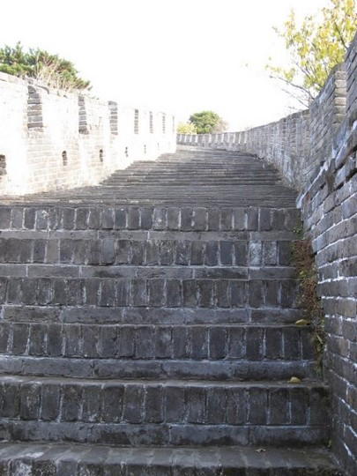
The Great Wall
Forced workers to close the gaps and extend the wall cover nearly the entire northern border

Slide 7
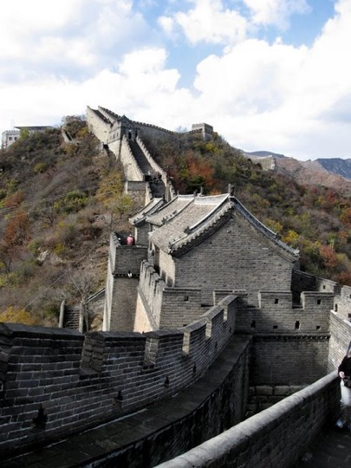
The Great Wall
forced labor and high taxes necessary for the wall’s construction made Shi Huangdi very unpopular

Slide 8
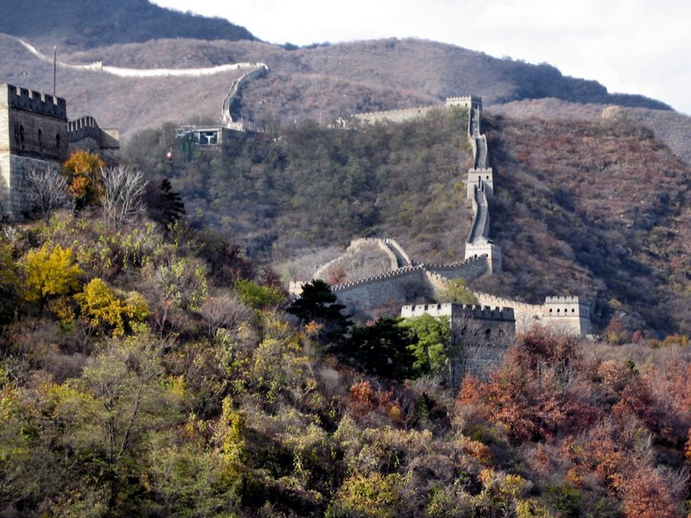

Slide 9
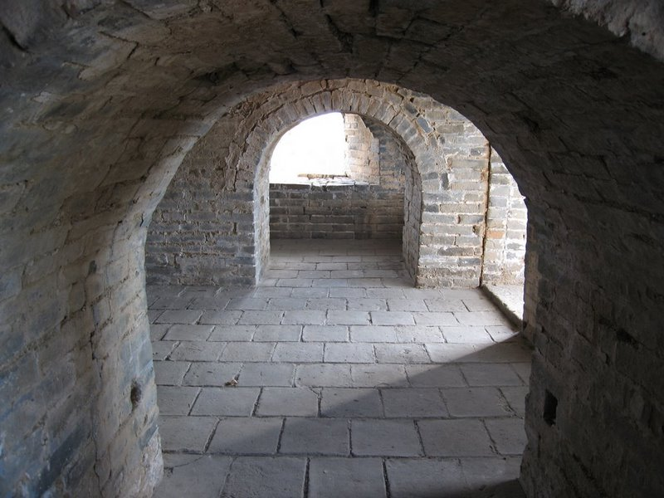

Slide 10
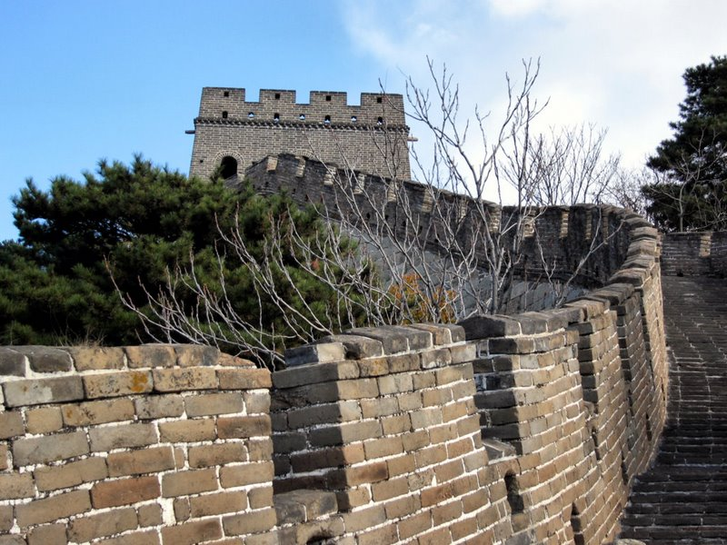

Slide 11
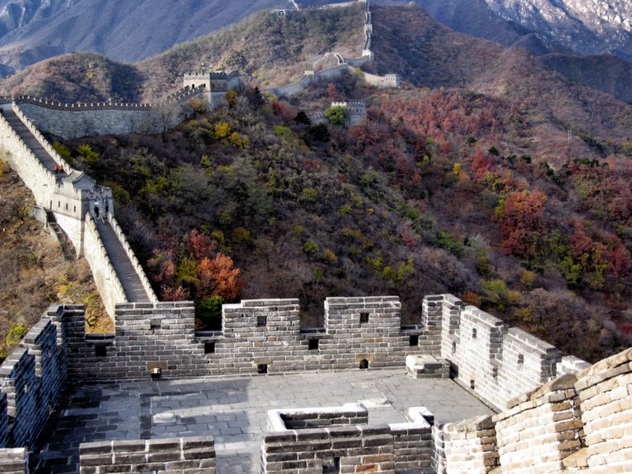

Slide 12
Fall of the Qin
By 206 BCE, the harsh rule of the Qin Dynasty was replaced by the Han

Slide 13
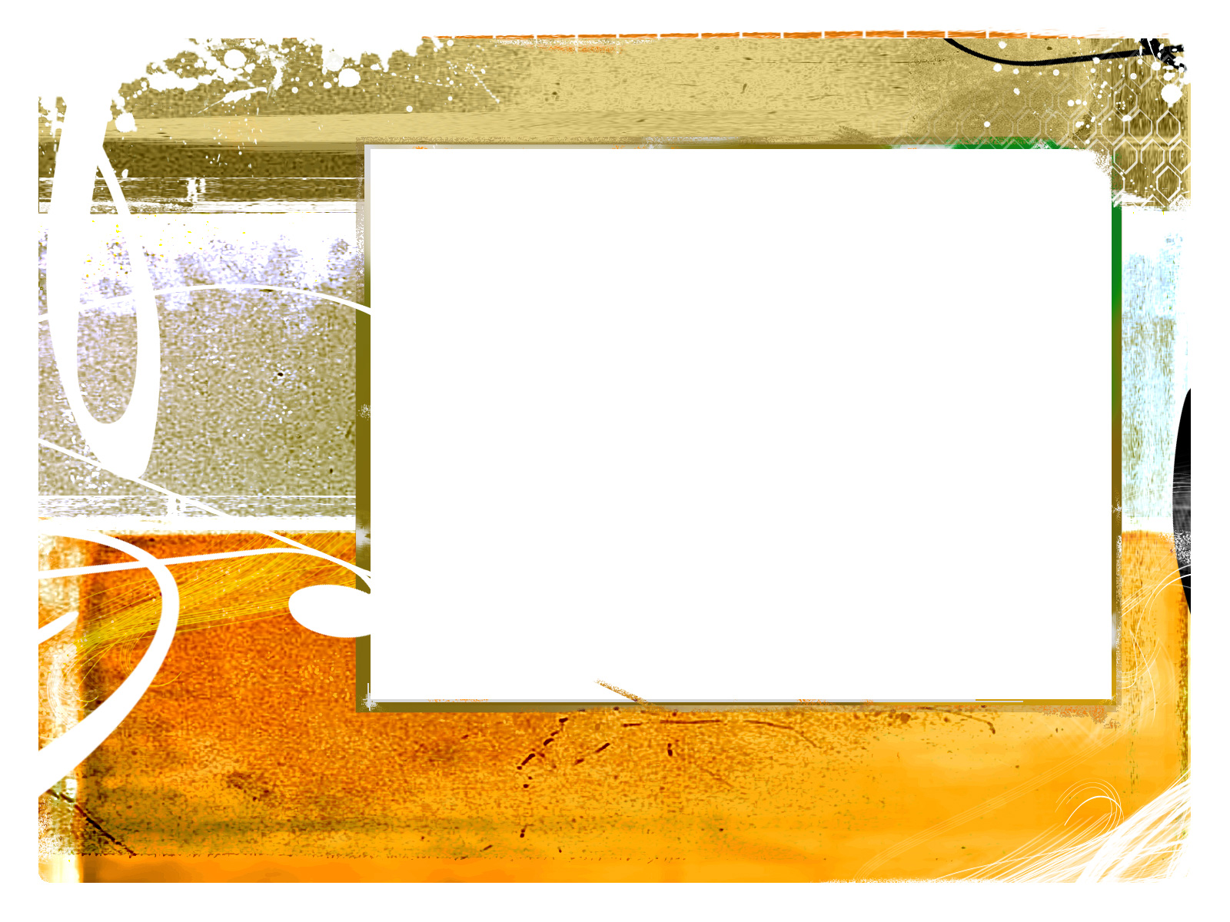
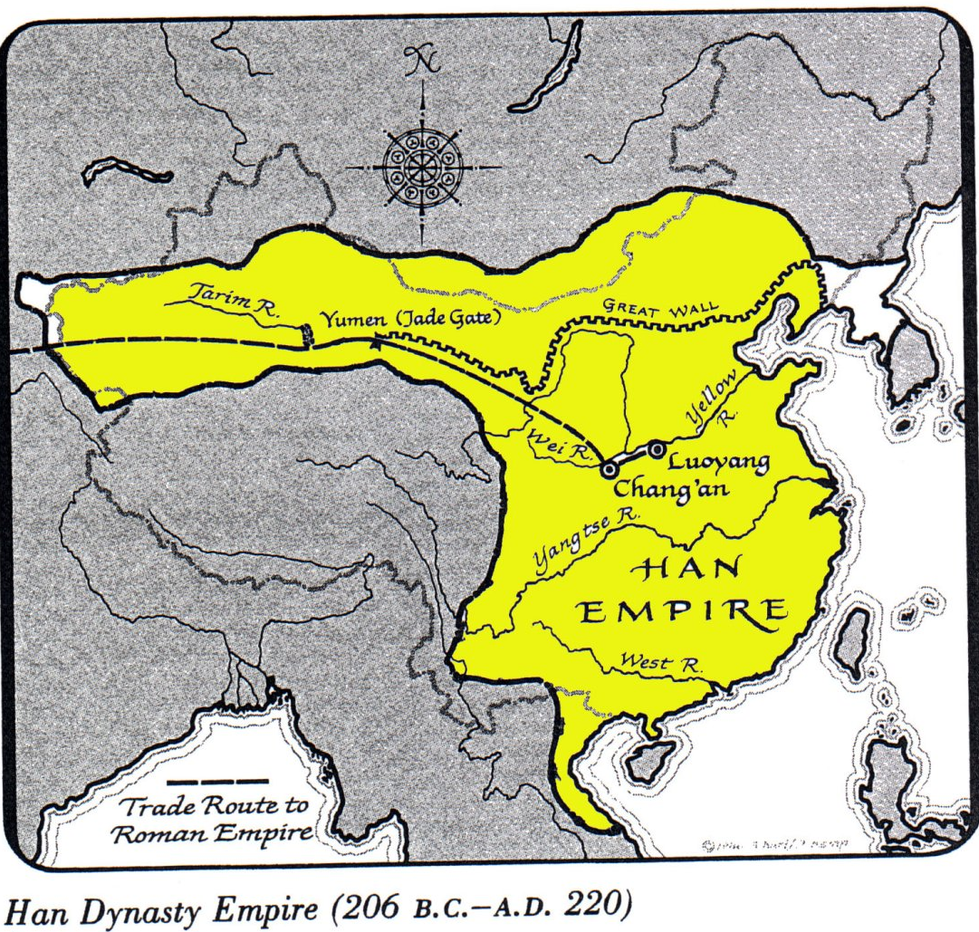
The Extent of the Han (206 BCE-220 CE)

Slide 14
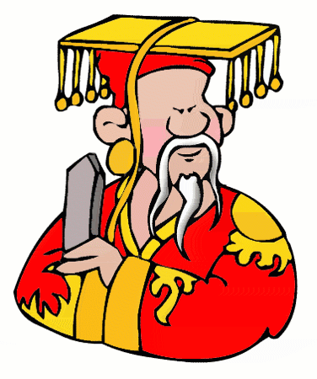
Rulers- Strengthening Government
Liu Bang: relied on Confucius policy rather than the harsh legalist ideals of Qin dynasty
Emperor Wudi: Most important emperor
  Relied on Confucianism
  Improved canals and roads
  Imposed a government monopoly (complete control of a product or business) on iron and salt

Slide 15
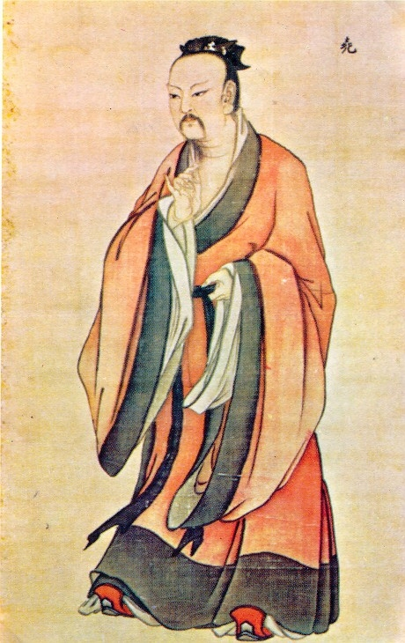
The Han under Wudi
Became known as the “Martial Emperor” because he expanded empire through war

Slide 16
Han Society
Scholar-Officials: well-educated philosophers (Confucianism) to run the bureaucracy
A scholar official was expected to match the Confucian ideal of a gentle man. He would be courteous and dignified and possess a thorough knowledge of history, music, poetry, and Confucian teachings.

Slide 17
Han Society
Civil Service Examinations
  Officials should win positions by merit rather than through family background.
  To find the most qualified officials they set up a system of exams
  In theory, any man could take the exam but in reality only those who could afford it – ended up taking it.

Slide 18
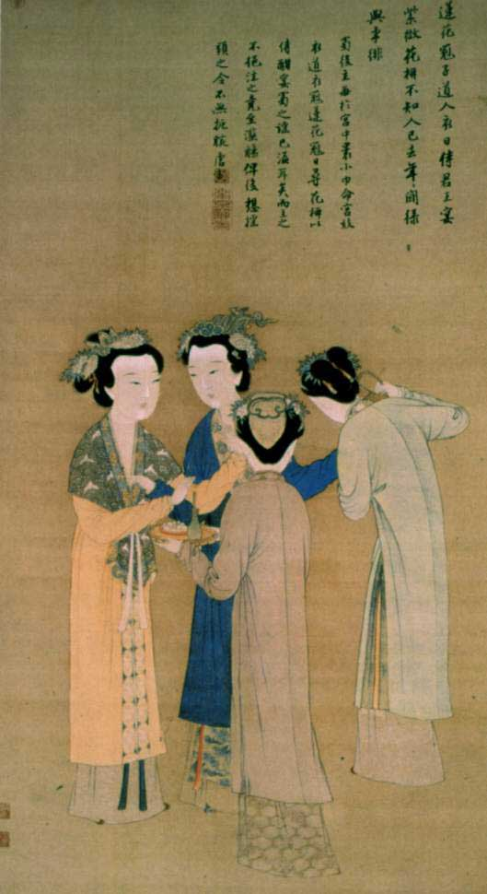
Han Society
Women
  Confucian teachings – men superior than women kept women from taking the civil service exams.
  “Lessons for women”
Source:: www.historyforkids.org

Slide 19
Technology and Trade
Technological improvements under the Han
  Paper, yokes, plow, wheelbarrow, improved iron tools, use of water power to grind grain
Agriculture was considered the most important profession in China, but trade still thrived under Han rule.
  Government monopolies produced silk which was traded as far west as Europe along the…

